Slide 1






Team No: 67
Case Competition
World Cup 2025
Waymo U.S. Growth Strategy
Sarath Pandranki
Seetham Naidu
Samith Konkyana
Farhat Shaik

Slide 2
EXECUTIVE SUMMARY
Recommendation
Depth-first expansion focused on dense metro cores before geographic breadth
Current
~8–10 Rides / Vehicle / Day
Market Analysis
~50% of economically viable U.S. ride demand is concentrated in dense urban cores
Customer Analysis
Top ~25% of high-frequency riders generate ~60% of total rides, enabling utilization-driven growth
Target
~18–20 Rides / Vehicle / Day
Competitive Analysis
Waymo is the only scaled, regulator-trusted robotaxi operator in the U.S.
Scale
(Achieved without fleet doubling)
~1.5-2x ride volume
Company Capabilities
ODD expansion and downtime reduction unlock utilization without adding fleet
Next Steps
Phased 3–5 years scaling governed by utilization, safety, and unit economics
Waymo’s highest-impact markets are those where autonomy already delivers outsized value, and a depth-first expansion in these markets converts proven performance into compounding gains in utilization, margins, and regulatory momentum.
Executive Summary
Market Analysis
Customer Analysis
Competitive Analysis
Company Capabilities
Next Steps

Slide 3
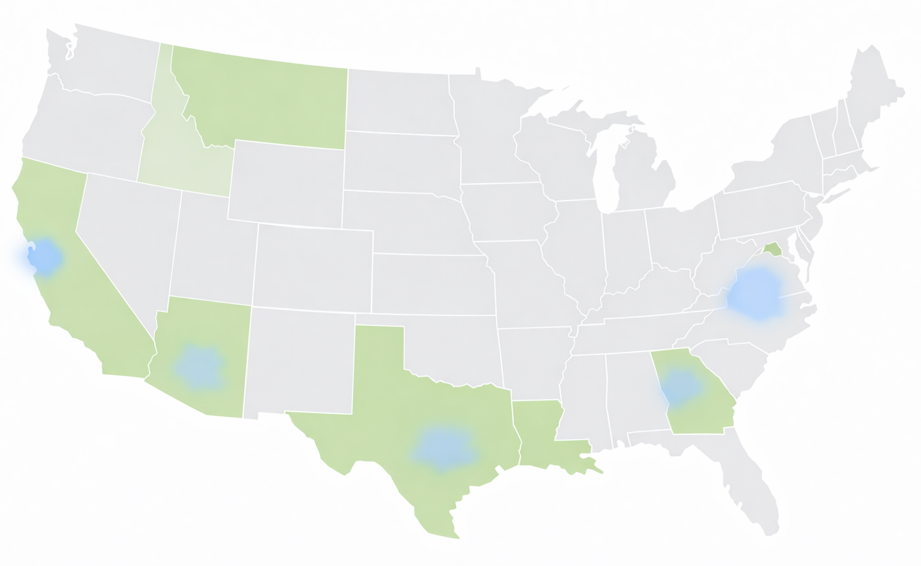
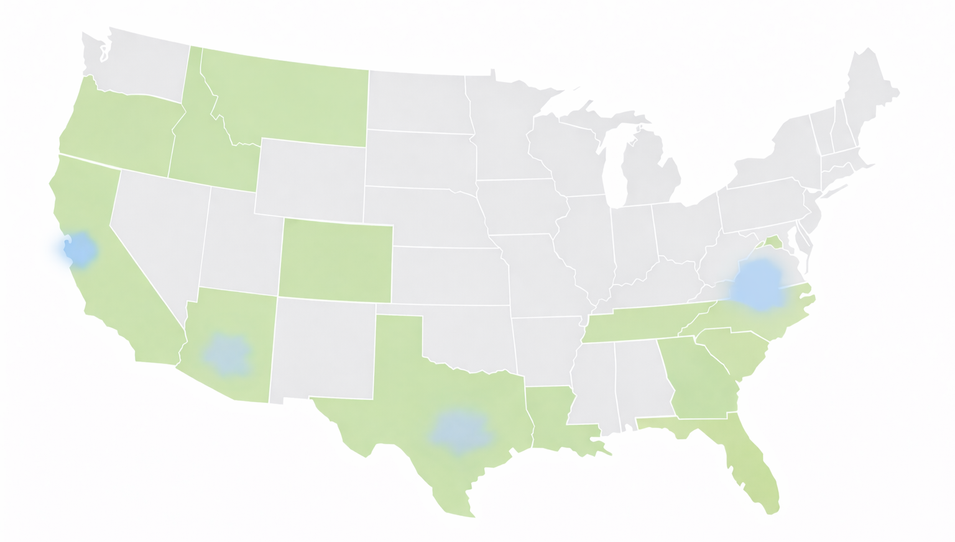
Economically Viable AV Demand Is Concentrated
Market Segment | % of U.S. Ride Demand | AV Economics
Dense metro cores | ~45–55% | High utilization, short trips
Suburban / sprawl | ~30–35% | Low repeatability
Low-density / rural | ~10–20% | Poor economics
KEY DRIVERS
Trip frequency
Trip Length
Deadhead miles
Local operations cost (40–50%)
KEY TAKEAWAYS
Half of monetizable U.S. ride demand occurs in <20% of urban geography
Dense metro cores are the real SAM for autonomous ride-hailing, combining demand density with congestion-relief priorities.
AV-friendly states (AZ, TX, NV, CA) materially reduce launch friction
Expansion outside cores sharply degrades utilization and margins
Waymo’s presence
AV-friendly states
Market Size
U.S. ride-hailing TAM ~$28.5B (2024)
Capturing even a small share implies millions of rides
Sources:
McKinsey(2026), Deloitte(2025), Dentons(2025), INRIX Mobility & Congestion Report(2017)
Executive Summary
Market Analysis
Customer Analysis
Competitive Analysis
Company Capabilities
Next Steps

Slide 4
Core Insight: Top ~25% of riders account for ~60% of total rides
Utilization Is Driven by High-Frequency Users
ADOPTION REALITY
~60–70% of Americans remain uneasy about AVs
Early economics depend on trust-driven, frequent users
PRIMARY RIDE-VOLUME LEVERS
Late-night and safety-driven trips
Employer-sponsored commuting programs
Fixed pickup hubs (airports, transit centers, event venues)
Opt-in shared rides on predictable routes
Lever | Volume Impact | Risk
Late-night focus | High | Low
Employer programs | Medium | Low
Fixed hubs | Medium | Low
Shared rides | Medium | Medium
Sources:
McKinsey(2026), McKinsey(2023), Nature HSS(2025), NEWSROOM(2025)
Executive Summary
Market Analysis
Customer Analysis
Competitive Analysis
Company Capabilities
Next Steps

Slide 5




Leading the Field in Safety and Regulatory Confidence
Competitive Landscape: Robotaxi Peers
Commercial Service | Active, multi-city | Paused / limited | Pilot-stage
Safety Record | Strong, transparent | Incident-driven pause | Developing
Regulatory Trust | High | Constrained | Developing
Why Waymo Wins?
Waymo reports ~85% fewer injury-reported crashes than human drivers.
Most mature L4 deployment, Strongest regulatory credibility, Only player operating at real scale
The AV landscape is fragmented across distinct markets, with only a few competing directly in urban robotaxi services.
What Behavior Is Waymo Replacing?
Private vehicles still account for >70% of urban trips
Sources: Case Prompt, Reuters AV Industry Coverage, California DMV AV Disengagement & Collision Reports
Executive Summary
Market Analysis
Customer Analysis
Competitive Analysis
Company Capabilities
Next Steps

Slide 6
Operational Levers That Improve Economics
Focused ODD Expansion
CORE URBAN
Cost per Mile
Downtime
Utilization
Airport corridors and high-yield urban routes
Incremental weather tolerance where economics justify complexity
Selective Partnerships for Demand Ramp
AIRPORT CORRIDORS
Partner-led distribution limited to early market entry (6–12 months)
Utilization-based exit thresholds
Pricing Competitiveness via Unit Economics
ADJACENT NEIGHBOURHOODS
Utilization-led cost reduction (target 18–20 rides/vehicle/day)
Concentration on high-frequency riders and peak windows
Route and dispatch optimization to maximize revenue miles
Direct technological advancement toward expanding revenue hours and reducing cost per mile.
Revenue miles must scale faster than fleet size to maintain margin headroom and competitive pricing.
Downtime Compression
Micro-charging hubs near demand clusters
Predictive vehicle rebalancing
Rapid-turn cleaning and maintenance
Sources: McKinsey(2025), World Economic Forum(2025), Arthur D. Little Autonomous Mobility Journal(2025)
Executive Summary
Market Analysis
Customer Analysis
Competitive Analysis
Company Capabilities
Next Steps

Slide 7
The roadmap compounds operational leverage before expanding footprint.
The Path Forward: A Repeatable Growth Model
Phase 1: Years 1–2
Phase 2: Years 2–3
Phase 3: Years 3–5
Deepen existing metros to unlock utilization stability
Selective expansion into AV-friendly metros with proven demand density
Replicate the proven playbook across 2–3 new metros
Expand ODD hours and key corridors
Compress downtime through micro-charging hubs, rapid resets, predictive rebalancing
Use partners (e.g., Uber) only for months 0–12 to eliminate cold starts
Transition to Waymo One as utilization stabilizes
Apply templated city launch model (mapping, corridor-first ODD, hub placement)
Expand price-sensitive trip penetration through improved cost per mile
GATE
GATE
GATE
Rides/vehicle/day ≥ 18
Safety rate at or better than current baseline
Positive contribution margin
Regulatory approvals with zero major interventions
Repeatable city-level economics
ODD readiness validated across local driving patterns
Executive Summary
Market Analysis
Customer Analysis
Competitive Analysis
Company Capabilities
Next Steps

